Slide 1
Serving Others
“If anyone wants to be first, he must make himself last of all and servant of all.” Mark 9:35
Opening Prayer:
God, thank-you for the greatest gift of all, your love. Help us to share this love with others by serving them. Amen
Cut out 15 hearts 2. Discuss: How can you serve each other in your family? How can you serve others that you know, at school, at clubs you go to, people at church and other people in your community?
Task Heading
Task
3. On each of the hearts write down different ways you could serve the people around you, they could be specific to a person e.g. “do my sister’s chores” or more general “bake someone a cake”

Slide 2
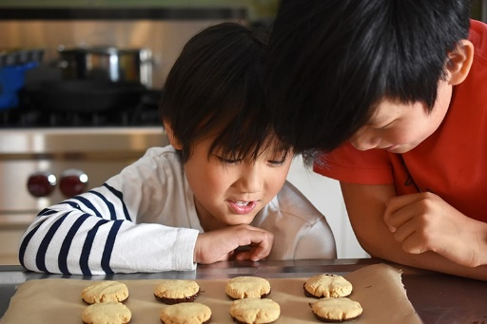
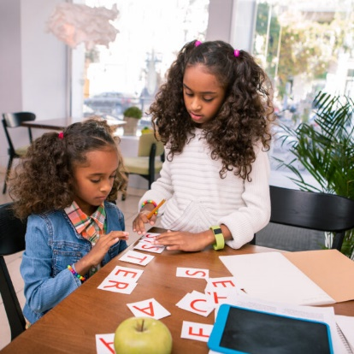
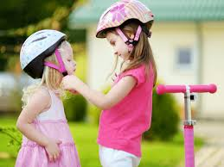
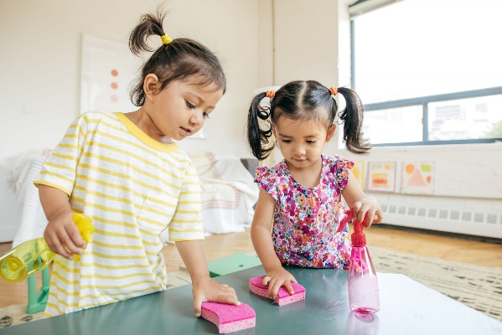
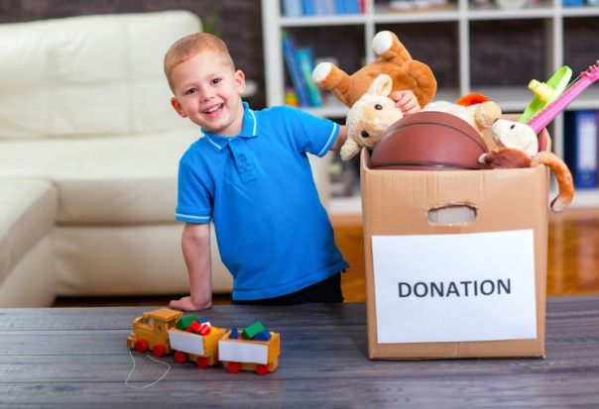
4. Each choose one heart and then try to serve others in this way over the next few days. 5. Once you have found a chance to share God’s love in this way, you could put the heart up on a wall or on your fridge to help remind you of ways you can put yourself last and serve others. This could be something you discuss at meals times this week, thinking about whether there are other hearts you could add to your collection – other ways you can be a “servant to all”.
Task Heading
Task

